Slide 1
JUnit Tests
By: Keith Jacobson

Slide 2
What is JUnit?
JUnit is a unit testing framework that was built for the Java programming language.
It has been important in the development of test-driven developing teams, and is actually one of the family of other unit testing frameworks; called xUnit and Sunit.
And it is linked as a JAR when compiled under framework package junit.framework.

Slide 3
Why JUnit?
To measure progress and also detect unintended side-effects (very important in coding.)
Run continuously.
Immediate results.
Shows a green bar that turns red when something has come up.
This should be run during development of all complex and critical parts of development in an application.

Slide 4
Eclipse Help:
When looking at how to write & run a JUnit tests: https://goo.gl/sTrkYT
The following couple of slides will actually be screen shots of how to do this→

Slide 5
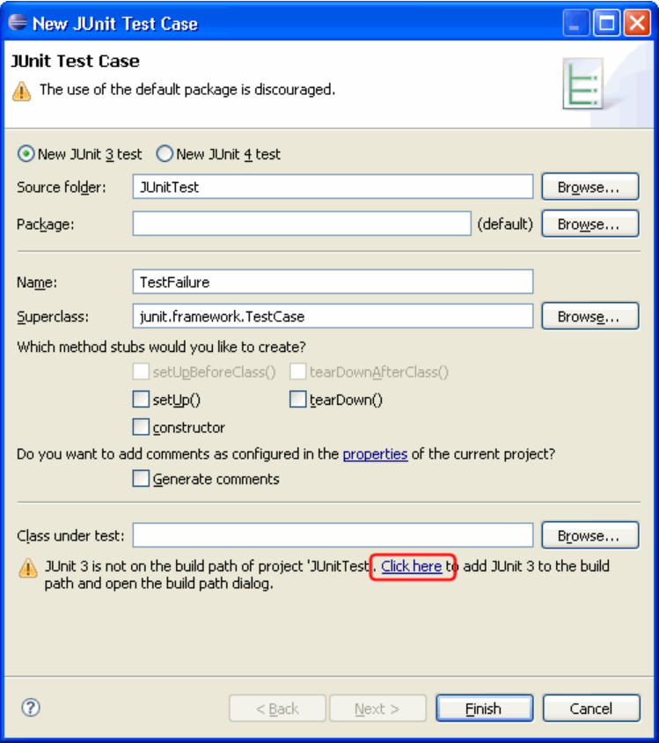
Writing Tests:
Create a project "JUnitTest". Now you can write your first test. You implement the test in a subclass of TestCase. You can do so either using the standard Class wizard or the specialized Test Case wizard:
Open the New wizard (File > New > JUnit Test Case).
Select New JUnit 3 test and enter "TestFailure" as the name of your test class:
Note: If you want to use JUnit 4 tests you have to make sure that your compiler compliance is set to 1.5.
You will see a warning message asking you to add the junit library to the build path. Use the Click here link to add the junit library automatically.
Click Finish to create the test class.
Add a test method that fails to the class TestFailure. A quick way to enter a test method is with the test template. To do so, place the cursor inside the class declaration. Type "test" followed by Ctrl+Space to activate code assist and select the "test" template. Change the name of the created method to testFailure and invoke the fail() method.
public void testFailure() throws Exception {
fail();
}
Now you are ready to run your first test.

Slide 6
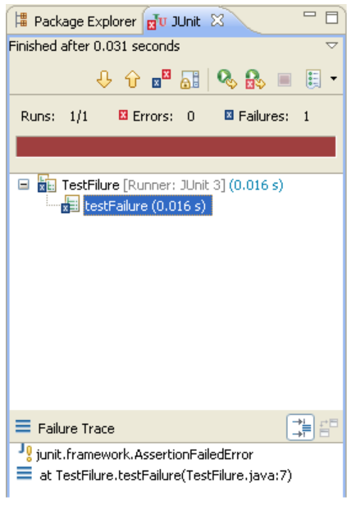
To run TestFailure hit the run button in the toolbar. It will automatically run as JUnit Test. You can inspect the test results in the JUnit view. This view shows you the test run progress and status:
Failed test
The view is shown in the current perspective whenever you start a test run. A convenient arrangement for the JUnit view is to dock it as a fast view. The JUnit view has two tabs: one shows you a list of failures and the other shows you the full test suite as a tree. You can navigate from a failure to the corresponding source by double clicking the corresponding line in the failure trace.
Dock the JUnit view as a fast view, remove the fail() statement in the method testFailure() so that the test passes and rerun the test again. You can rerun a test either by clicking the Rerun button in the view's tool bar or you can re-run the program that was last launched by activating the Run drop down. This time the test should succeed. Because the test was successful, the JUnit view doesn't pop up, but the success indicator shows on the JUnit view icon and the status line shows the test result. As a reminder to rerun your tests the view icon is decorated by a "*" whenever you change the workspace contents after the run.

Slide 7
CONTINUED-
Successful test - A successful test run
Successful test but workspace has changed - A successful test run, but the workspace contents have changed since the last test run.
In addition to running a test case as described above you can also:
Run all tests inside a project, source folder, or package -
Select a project, package or source folder and run all the included tests with Run as > JUnit Test. This command finds all tests inside a project, source folder or package and executes them.
Run a single test method -
Select a test method in the Outline or Package Explorer and with Run as > JUnit Test the selected test method will be run.
Rerun a single test -
Select a test in the JUnit view and execute Run from the context menu.

Slide 8
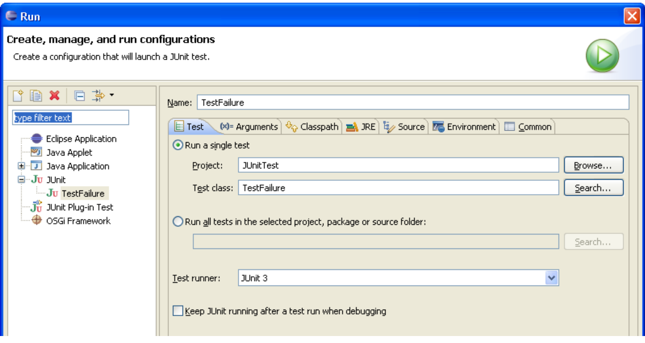
Customizing a Test Configuration
When you want to pass parameters or customize the settings for a test run you open the Launch Configuration Dialog. Select Open Run Dialog....in the Run drop-down menu in the toolbar:
JUnit Launch Configuration
In this dialog you can specify the test to be run, its arguments, its run-time class path, and the Java run-time environment.
Debugging a Test Failure
In the case of a test failure you can follow these steps to debug it:
1. Double click the failure entry from the Failures tab in the JUnit view to open the corresponding file in the editor.
2. Set a breakpoint at the beginning of the test method.
3. Select the test case and execute Debug As>JUnit Test from the Debug drop down.
A JUnit launch configuration has a "keep alive" option. If your Java virtual machine supports "hot code replacement" you can fix the code and rerun the test without restarting the full test run. To enable this option select the Keep JUnit running after a test run when debugging checkbox in the JUnit launch configuration.

Slide 9
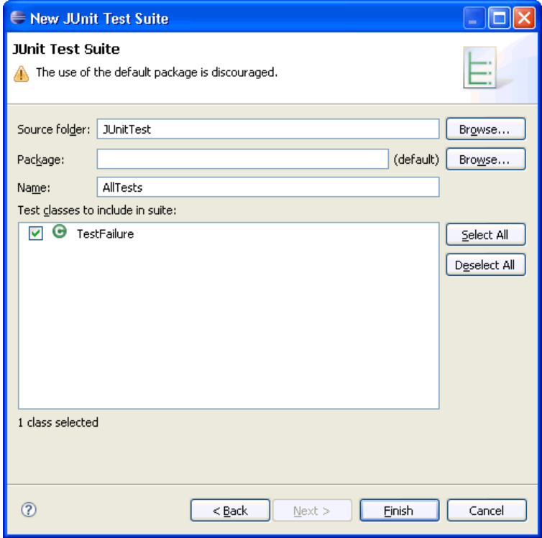
Creating a Test Suite
The JUnit TestSuite wizard helps you with the creation of a test suite. You can select the set of classes that should belong to a suite.
Open the New wizard
Select Java > JUnit > JUnit Test Suite and click Next.
Enter a name for your test suite class (the convention is to use "AllTests" which appears by default).
Test Suite wizard
Select the classes that should be included in the suite. We currently have a single test class only, but you can add to the suite later.
You can add or remove test classes from the test suite in two ways:
Manually by editing the test suite file
By re-running the wizard and selecting the new set of test classes.
Note: the wizard puts 2 markers, //$JUnit-BEGIN$ and //$JUnit-END$, into the created Test suite class, which allows the wizard to update existing test suite classes. Editing code between the markers is not recommended.

